Slide 1

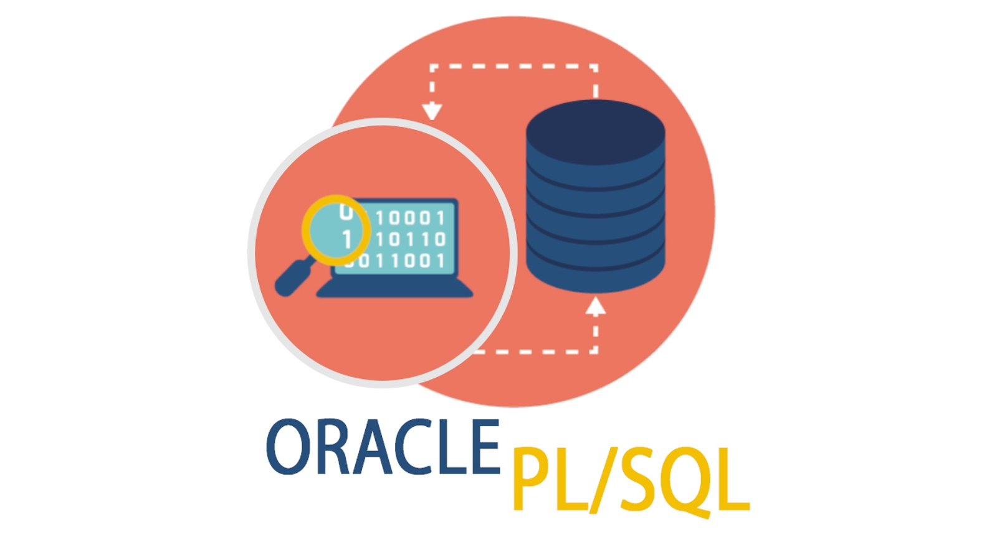
Database development with PL/SQL INSY 8311
Instructor:
Eric Maniraguha | ericmaniraguha2024@gmail.com | LinkedIn Profile
6h00 pm – 8h50 pm
Monday A -G209
Tuesday B-G209
Wednesday E-G209
Thursday F-G308
February 2025

Slide 2

Database development with PL/SQL
Reference reading
What is PL/SQL? Explained
PL/SQL Exception Handling in All Details
Lecture 05 – Error Handling & Control Structures
Notes:
In PL/SQL (Procedural Language/Structured Query Language), procedures are essential for several reasons:
1. Code Reusability
Procedures allow you to write a block of code once and reuse it multiple times, reducing redundancy.
2. Modularity
Large applications can be broken into smaller, manageable pieces by using procedures, making maintenance easier.
3. Performance Optimization
Procedures execute as a single unit, reducing network traffic between applications and the database.
They are compiled once and stored in the database, leading to faster execution.
4. Security and Access Control
Procedures can be granted execution privileges to users without giving direct access to the underlying tables.
5. Error Handling
PL/SQL provides structured exception handling within procedures to manage errors efficiently.
6. Encapsulation and Abstraction
Business logic can be encapsulated in procedures, keeping it separate from the application logic.
7. Reduced Network Load
Instead of sending multiple SQL statements over the network, a single procedure call can execute multiple operations.

Slide 3
Error Handling in PL/SQL & Control Structures
2. PL/SQL provides control structures that allow developers to manage the flow of execution in a program. These include:
A. Conditional Statements – Used for decision-making (IF...THEN, CASE).
B. Iterative Statements – Used for looping (LOOP, WHILE, FOR).
C. Sequential Control – Controls the order of execution (GOTO, NULL).
1. Error Handling Mechanisms – Handles runtime exceptions (EXCEPTION block).
Notes:
Why Do We Need Error Handling in PL/SQL?
Error handling in PL/SQL is crucial for ensuring the smooth execution of database operations. Here’s why:
1. Prevents Program Crashes
Errors like divide by zero, NULL values, or constraint violations can cause a program to fail.
Proper error handling ensures the program doesn’t abruptly stop but instead takes corrective actions.
2. Improves Debugging & Logging
Capturing and logging errors helps developers identify the root cause of issues quickly.
You can log errors into a table for future analysis.
3. Maintains Data Integrity
Errors can lead to partial updates or inconsistencies in data.
Using ROLLBACK in error handling ensures that transactions are either fully completed or fully undone.
4. Enhances User Experience
Instead of cryptic system messages, user-friendly messages can be displayed.
Example: Instead of showing "ORA-01403: No Data Found", you can display "No records found for the given ID."
5. Allows Graceful Recovery
If an error occurs, alternative actions (like retrying or executing fallback logic) can be taken instead of terminating the process.

Slide 4
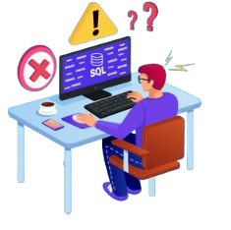
Exception Handling in PL/SQL
Introduction
An exception is an error that disrupts the normal flow of program execution. PL/SQL provides exception handling mechanisms to identify, catch, and manage errors, allowing programmers to debug and resolve issues effectively.
System-defined exceptions or Named system exceptions
User-defined exceptions or Unnamed System exceptions
These are predefined exceptions raised automatically by the system when an error occurs.
These are explicitly declared and raised by the programmer using the RAISE statement.
Two Types of Exceptions in PL/SQL
Notes:
Named system Exceptions
The named PL/SQL exceptions are named in the standard package of PL/SQL, hence the developer does not need to define the PL/SQL exceptions in their code. PL/SQL provides many pre-defined named exceptions, which are executed when any database rule is violated by a program. The following table lists a few of the important pre-defined exceptions −
The System-defined exceptions are further divided into two categories:
Named system exceptions or pre-defined named exceptions
Unnamed system exceptions: expressed Exceptions

Slide 5
1. System-Defined Exceptions
Exception | Oracle Error | SQLCODE | Description
ACCESS_INTO_NULL | 06530 | -6530 | It is raised when a null object is automatically assigned a value.
CASE_NOT_FOUND | 06592 | -6592 | It is raised when none of the choices in the WHEN clause of a CASE statement is selected, and there is no ELSE clause.
COLLECTION_IS_NULL | 06531 | -6531 | It is raised when a program attempts to apply collection methods other than EXISTS to an uninitialized nested table or varray, or the program attempts to assign values to the elements of an uninitialized nested table or varray.
DUP_VAL_ON_INDEX | 00001 | -1 | It is raised when duplicate values are attempted to be stored in a column with a unique index.
INVALID_CURSOR | 01001 | -1001 | It is raised when attempts are made to make a cursor operation that is not allowed, such as closing an unopened cursor.
INVALID_NUMBER | 01722 | -1722 | It is raised when the conversion of a character string into a number fails because the string does not represent a valid number.
LOGIN_DENIED | 01017 | -1017 | It is raised when a program attempts to log on to the database with an invalid username or password.
NO_DATA_FOUND | 01403 | +100 | It is raised when a SELECT INTO statement returns no rows.
NOT_LOGGED_ON | 01012 | -1012 | It is raised when a database call is issued without being connected to the database.
PROGRAM_ERROR | 06501 | -6501 | It is raised when PL/SQL has an internal problem.
ROWTYPE_MISMATCH | 06504 | -6504 | This is raised when a cursor fetches value in a variable having incompatible data type.
SELF_IS_NULL | 30625 | -30625 | This is raised when a member method is invoked, but the instance of the object type was not initialized.
STORAGE_ERROR | 06500 | -6500 | It is raised when PL/SQL ran out of memory or memory was corrupted.
TOO_MANY_ROWS | 01422 | -1422 | This is raised when a SELECT INTO statement returns more than one row.
VALUE_ERROR | 06502 | -6502 | It is raised when an arithmetic, conversion, truncation, or size constraint error occurs.
ZERO_DIVIDE | 01476 | 1476 | It is raised when an attempt is made to divide a number by zero.
Notes:
Commonly Used Predefined Exceptions in PL/SQL
System-defined exceptions are automatically raised when a predefined error occurs during execution.

Slide 6
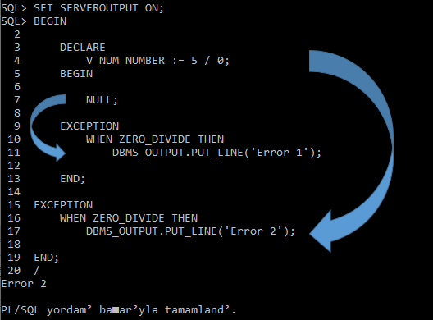
Syntax for Handling System-Defined Exceptions
BEGIN
--Code that may raise an exception
EXCEPTION
WHEN NO_DATA_FOUND THEN
DBMS_OUTPUT.PUT_LINE('No data found!');
WHEN ZERO_DIVIDE THEN
DBMS_OUTPUT.PUT_LINE('Attempted to divide by zero!');
WHEN OTHERS THEN
DBMS_OUTPUT.PUT_LINE('Some other error occurred.’);
END;
Syntax for Handling System-Defined Exceptions
What Happens During Execution?
The declaration section of the block (DECLARE V_NUM NUMBER := 5 / 0;) attempts to divide by zero.
Since division by zero is not allowed, a ZERO_DIVIDE exception is raised immediately.
The exception occurs before entering the inner BEGIN ... END; block, meaning the inner block’s EXCEPTION section is never reached.
The exception propagates directly to the outer block's EXCEPTION section.
The WHEN ZERO_DIVIDE THEN block in the outer exception handler catches the error and executes:
The output prints "Error 2" because the inner block never gets control due to the exception occurring at the declaration stage.
DBMS_OUTPUT.PUT_LINE('Error 2');
Notes:
Breakdown of the Code:
V_NUM NUMBER := 5 / 0;
This causes a ZERO_DIVIDE exception because division by zero is not allowed.
Nested Block Begins (BEGIN ... EXCEPTION ... END;)
Inside this block, there is no actual operation (just NULL;), but it does not catch the ZERO_DIVIDE error because the error occurs before the nested block starts executing.
Exception Handling at the Outer Block
Since the inner block does not handle the exception, it is propagated to the outer block.
The outer block catches ZERO_DIVIDE and prints Error 2.

Slide 7
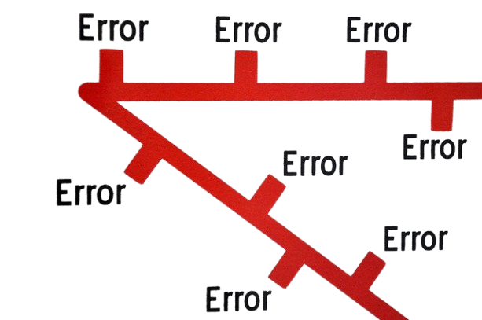
2. User-Defined Exceptions
User-defined exceptions are explicitly declared and raised using the RAISE statement. These are useful when the system-defined exceptions are not sufficient.
Steps to Handle User-Defined Exceptions
1. Declare the exception.
2. Raise the exception using the RAISE statement.
3. Handle the exception in the EXCEPTION block.

Slide 8
Syntax for Declaring and Handling
DECLARE
insufficient_balance EXCEPTION;
current_balance NUMBER := 500;
withdrawal_amount NUMBER := 1000;
BEGIN
IF withdrawal_amount > current_balance THEN
RAISE insufficient_balance;
END IF;
DBMS_OUTPUT.PUT_LINE('Withdrawal successful!’);
EXCEPTION
WHEN insufficient_balance THEN
DBMS_OUTPUT.PUT_LINE('Error: Insufficient Balance!’);
END;
2. Handling User-Defined Exceptions
DECLARE
table_not_found EXCEPTION;
PRAGMA EXCEPTION_INIT(table_not_found, -00942);
BEGIN
EXECUTE IMMEDIATE 'SELECT * FROM non_existing_table’;
EXCEPTION WHEN table_not_found THEN
DBMS_OUTPUT.PUT_LINE('Error: Table does not exist!’);
END;
3. Using PRAGMA EXCEPTION_INIT
PL/SQL allows you to associate a user-defined exception with a system-defined error using PRAGMA EXCEPTION_INIT.
Notes:
What is EXECUTE IMMEDIATE in PL/SQL?
EXECUTE IMMEDIATE is a PL/SQL statement that allows you to run dynamic SQL queries at runtime. Unlike static SQL (which is known at compile time), dynamic SQL is built and executed during program execution.
📌 Why Use EXECUTE IMMEDIATE?
Execute SQL Statements Dynamically
Useful when the SQL statement is unknown at compile time.
Example: Running queries on tables that change dynamically.
Work with Dynamic Table Names, Columns, or Conditions
Helps when working with user-defined inputs.
Execute DDL (Data Definition Language) Statements
Commands like CREATE TABLE, DROP TABLE, or ALTER TABLE cannot be executed directly inside PL/SQL.
EXECUTE IMMEDIATE allows running these commands.
Improve Performance in Certain Cases
Useful for handling complex queries dynamically.
BEGIN
EXECUTE IMMEDIATE 'SELECT COUNT(*) FROM employees';
END;
Where is the User-Defined Exception?
table_not_found EXCEPTION;
This declares a custom exception named table_not_found.
PRAGMA EXCEPTION_INIT(table_not_found, -00942);
This associates the custom exception table_not_found with Oracle error code ORA-00942 (Table or View does not exist).
This means whenever error -00942 occurs, Oracle will automatically raise table_not_found.
How it Works in the Code:
The EXECUTE IMMEDIATE statement attempts to run a dynamic SQL query on a non-existing table.
Oracle raises ORA-00942 (Table does not exist).
Since PRAGMA EXCEPTION_INIT links table_not_found to this error, the EXCEPTION block catches it and executes:
plsql
CopyEdit

Slide 9
RAISE_APPLICATION_ERROR & Summary
DECLARE
invalid_age EXCEPTION;
BEGIN
RAISE_APPLICATION_ERROR(-20001, 'Age cannot be negative!’);
EXCEPTION
WHEN OTHERS THEN
DBMS_OUTPUT.PUT_LINE(SQLERRM);
END;
4. Syntax for RAISE_APPLICATION_ERROR
The RAISE_APPLICATION_ERROR procedure allows you to generate a custom error message with a specific error number.
Summary
PL/SQL provides exception handling to deal with errors efficiently.
There are system-defined exceptions (predefined) and user-defined exceptions (declared by the user).
RAISE is used to trigger user-defined exceptions.
PRAGMA EXCEPTION_INIT links a system error with a user-defined exception.
RAISE_APPLICATION_ERROR allows generating custom error messages.
With proper exception handling, PL/SQL programs become more robust and reliable.
Notes:
Error -20001 is a user-defined error code raised using RAISE_APPLICATION_ERROR. This error code falls within the range of -20000 to -20999, which Oracle reserves for custom application errors.
✔ What Happens?
Error is Raised: RAISE_APPLICATION_ERROR(-20001, 'Age cannot be negative!');
Exception is Caught: The WHEN OTHERS block catches all exceptions.
SQLERRM Displays: ORA-20001: Age cannot be negative!
📌 Issue in the Code: The declaration of invalid_age EXCEPTION; is unnecessary because the custom error is being raised using RAISE_APPLICATION_ERROR.
Explanation:
RAISE_APPLICATION_ERROR is used to generate a custom error message.
-20001 is an arbitrary error code within the range Oracle allows for user-defined errors.
The second parameter ('Age cannot be negative!') is the custom error message.
What is SQLERRM in PL/SQL?
SQLERRM is a built-in function in PL/SQL that returns the error message associated with the most recent exception. It is typically used in exception handling to provide details about the error that occurred.

Slide 10
Using SQLERRM to Capture Any Error
Example 1: Using SQLERRM to Capture Any Error
DECLARE
v_divisor NUMBER := 0;
v_result NUMBER;
BEGIN
-- This will cause a division-by-zero error
v_result := 10 / v_divisor;
EXCEPTION
WHEN OTHERS THEN
DBMS_OUTPUT.PUT_LINE('Error occurred: ' || SQLERRM);
END;
/
✔ Expected Output:
Error occurred: ORA-01476: divisor is equal to zero
Example 2: Using SQLERRM in a Procedure
CREATE OR REPLACE PROCEDURE update_salary(p_emp_id IN NUMBER, p_salary IN NUMBER) AS
BEGIN
UPDATE employees
SET salary = p_salary
WHERE emp_id = p_emp_id;
COMMIT;
DBMS_OUTPUT.PUT_LINE('Salary updated successfully.');
EXCEPTION
WHEN OTHERS THEN
DBMS_OUTPUT.PUT_LINE('Error updating salary: ' || SQLERRM);
ROLLBACK;
END;
/
✔ What Happens?
If an error occurs (e.g., p_emp_id doesn't exist), it captures the error message and prevents
a failed transaction.

Slide 11

Exception or Error Handling in PL/SQL – Problem Definition
We need to manage a students table that stores student details. The table should include:
student_id (Primary Key)
name (VARCHAR)
age (NUMBER)
grade (VARCHAR)
We will:
Create a procedure (create_students_table) to create the table.
Insert records into the table with error handling.
Update records while ensuring rollback in case of an error.
Implement exception handling to ensure the application doesn't crash.
Notes:
Explanation of the Script
1. Creating the Table using a Procedure
EXECUTE IMMEDIATE is used to create the students table dynamically.
Exception handling is in place to catch errors if the table already exists.
2. Inserting Data with Exception Handling
Three records are inserted.
The third record causes a Primary Key Violation, which is handled using PRAGMA EXCEPTION_INIT.
3. Updating Data with Rollback
The age of student_id = 2 is updated.
If the age goes below 18, a custom error (-20002) is raised.
ROLLBACK TO SAVEPOINT ensures that only the failed part is undone.

Slide 12
PL/SQL Script Implementation: Table Creation & Data Insertion
-- 1. Procedure to create the table
CREATE OR REPLACE PROCEDURE create_students_table AS
BEGIN
EXECUTE IMMEDIATE 'CREATE TABLE students (
student_id NUMBER PRIMARY KEY,
name VARCHAR2(100),
age NUMBER,
grade VARCHAR2(10)
)';
DBMS_OUTPUT.PUT_LINE('Table "students" created successfully.');
EXCEPTION
WHEN OTHERS THEN
DBMS_OUTPUT.PUT_LINE('Error Creating Table: ' || SQLERRM);
END;
/
-- 2. Insert Data with Exception Handling
DECLARE
student_exists EXCEPTION;
PRAGMA EXCEPTION_INIT(student_exists, -1); -- -1 for duplicate primary key error
BEGIN
INSERT INTO students (student_id, name, age, grade)
VALUES (1, 'Alice Johnson', 20, 'A');
INSERT INTO students (student_id, name, age, grade)
VALUES (2, 'Bob Smith', 19, 'B');
INSERT INTO students (student_id, name, age, grade)
VALUES (1, 'Charlie Brown', 21, 'C'); -- This will cause a primary key violation
COMMIT; -- If no error occurs, commit the transaction
DBMS_OUTPUT.PUT_LINE('All records inserted successfully.');
EXCEPTION
WHEN student_exists THEN
DBMS_OUTPUT.PUT_LINE('Duplicate Entry: Student ID already exists.');
WHEN OTHERS THEN
DBMS_OUTPUT.PUT_LINE('Error Inserting Data: ' || SQLERRM);
END;
/
Notes:
Explanation of the Script
1. Creating the Table using a Procedure
EXECUTE IMMEDIATE is used to create the students table dynamically.
Exception handling is in place to catch errors if the table already exists.
2. Inserting Data with Exception Handling
Three records are inserted.
The third record causes a Primary Key Violation, which is handled using PRAGMA EXCEPTION_INIT.
3. Updating Data with Rollback
The age of student_id = 2 is updated.
If the age goes below 18, a custom error (-20002) is raised.
ROLLBACK TO SAVEPOINT ensures that only the failed part is undone.

Slide 13
PL/SQL Script Implementation - Update
-- 3. Update Data with Error Handling and Rollback
DECLARE
insufficient_age EXCEPTION;
PRAGMA EXCEPTION_INIT(insufficient_age, -20002);
BEGIN
SAVEPOINT before_update;
UPDATE students
SET age = 17
WHERE student_id = 2;
-- Check if age is below the allowed limit (18)
IF (SELECT age FROM students WHERE student_id = 2) < 18 THEN
RAISE_APPLICATION_ERROR(-20002, 'Age cannot be below 18.');
END IF;
COMMIT; -- Commit the transaction if successful
DBMS_OUTPUT.PUT_LINE('Update successful.');
EXCEPTION
WHEN insufficient_age THEN
ROLLBACK TO before_update;
DBMS_OUTPUT.PUT_LINE('Transaction rolled back: ' || SQLERRM);
WHEN OTHERS THEN
ROLLBACK;
DBMS_OUTPUT.PUT_LINE('Unexpected error: ' || SQLERRM);
END;
/
Notes:
Commonly Used Predefined Exceptions in PL/SQL
System-defined exceptions are automatically raised when a predefined error occurs during execution.

Slide 14
Here’s parameterized PL/SQL procedure to handle updates with error handling and rollback
CREATE OR REPLACE PROCEDURE update_student_age (
p_student_id IN NUMBER,
p_new_age IN NUMBER
) AS
insufficient_age EXCEPTION;
PRAGMA EXCEPTION_INIT(insufficient_age, -20002);
BEGIN
SAVEPOINT before_update;
-- Update the student's age
UPDATE students
SET age = p_new_age
WHERE student_id = p_student_id;
-- Check if age is below the allowed limit (18)
IF p_new_age < 18 THEN
RAISE_APPLICATION_ERROR(-20002, 'Age cannot be below 18.');
END IF;
COMMIT; -- Commit the transaction if successful
DBMS_OUTPUT.PUT_LINE('Update successful.');
EXCEPTION
WHEN insufficient_age THEN
ROLLBACK TO before_update;
DBMS_OUTPUT.PUT_LINE('Transaction rolled back: ' || SQLERRM);
WHEN OTHERS THEN
ROLLBACK;
DBMS_OUTPUT.PUT_LINE('Unexpected error: ' || SQLERRM);
END;
/
-- Call the procedure with parameters
BEGIN
update_student_age(2, 17); -- This will trigger a rollback
END;
/
Notes:
Modifications Done:
✔ Parameterized student_id and new_age ✔ Maintained rollback mechanism ✔ Handles unexpected errors (WHEN OTHERS)

Slide 15

Parameterized PL/SQL procedure to handle updates with error handling and rollback
CREATE OR REPLACE PROCEDURE update_student_age (
p_student_id IN NUMBER,
p_new_age IN NUMBER
) AS
insufficient_age EXCEPTION;
PRAGMA EXCEPTION_INIT(insufficient_age, -20002);
BEGIN
SAVEPOINT before_update;
-- Update the student's age
UPDATE students
SET age = p_new_age
WHERE student_id = p_student_id;
-- Check if age is below the allowed limit (18)
IF p_new_age < 18 THEN
RAISE_APPLICATION_ERROR(-20002, 'Age cannot be below 18.');
END IF;
COMMIT; -- Commit the transaction if successful
DBMS_OUTPUT.PUT_LINE('Update successful.');
EXCEPTION
WHEN insufficient_age THEN
ROLLBACK TO before_update;
DBMS_OUTPUT.PUT_LINE('Transaction rolled back: ' || SQLERRM);
WHEN OTHERS THEN
ROLLBACK;
DBMS_OUTPUT.PUT_LINE('Unexpected error: ' || SQLERRM);
END;
/
Summary of Best Practices
✔ Place COMMIT inside the main block (before exceptions). ✔ Use ROLLBACK only in exception handling. ✔ Never COMMIT after handling an exception, as the transaction is already undone.
Notes:
Key Issues and Consequences:
Successful Execution Still Requires a Commit
If the procedure runs without errors, there will be no explicit COMMIT before reaching the exception block.
This means if no exception occurs, the update is not committed, and the session may retain an open transaction.
Committing After a Rollback is Risky
If an error occurs and you ROLLBACK, then calling COMMIT afterward makes no sense because there is nothing left to commit—the rollback has already undone all changes.
This could also override the intended rollback behavior.
Possible Data Integrity Issues
If an exception occurs, but the COMMIT is still executed, you might commit a partial transaction instead of rolling back properly.
Example: If the update is executed but later fails due to an exception (like insufficient_age), the rollback should fully revert changes, not allow any committed state.

Slide 16

What Happens If You Move COMMIT Under EXCEPTION?
If you move COMMIT inside the EXCEPTION block (after handling all exceptions), the behavior of your procedure changes significantly, and it could introduce unintended side effects.
Key Issues and Consequences:
Successful Execution Still Requires a Commit
If the procedure runs without errors, there will be no explicit COMMIT before reaching the exception block.
This means if no exception occurs, the update is not committed, and the session may retain an open transaction.
Committing After a Rollback is Risky
If an error occurs and you ROLLBACK, then calling COMMIT afterward makes no sense because there is nothing left to commit—the rollback has already undone all changes.
This could also override the intended rollback behavior.
Possible Data Integrity Issues
If an exception occurs, but the COMMIT is still executed, you might commit a partial transaction instead of rolling back properly.
Example: If the update is executed but later fails due to an exception (like insufficient_age), the rollback should fully revert changes, not allow any committed state.
Notes:
Key Issues and Consequences:
Successful Execution Still Requires a Commit
If the procedure runs without errors, there will be no explicit COMMIT before reaching the exception block.
This means if no exception occurs, the update is not committed, and the session may retain an open transaction.
Committing After a Rollback is Risky
If an error occurs and you ROLLBACK, then calling COMMIT afterward makes no sense because there is nothing left to commit—the rollback has already undone all changes.
This could also override the intended rollback behavior.
Possible Data Integrity Issues
If an exception occurs, but the COMMIT is still executed, you might commit a partial transaction instead of rolling back properly.
Example: If the update is executed but later fails due to an exception (like insufficient_age), the rollback should fully revert changes, not allow any committed state.

Slide 17
Example - Logging Errors with SQLERRM
If you want to store errors in an error log table, you can use SQLERRM inside an EXCEPTION block:
CREATE TABLE error_log (
error_id NUMBER GENERATED ALWAYS AS IDENTITY,
error_message VARCHAR2(4000),
error_time TIMESTAMP DEFAULT SYSTIMESTAMP
);
CREATE OR REPLACE PROCEDURE insert_student(p_name IN VARCHAR2, p_age IN NUMBER) AS
BEGIN
INSERT INTO students (name, age) VALUES (p_name, p_age);
COMMIT;
EXCEPTION
WHEN OTHERS THEN
INSERT INTO error_log (error_message) VALUES (SQLERRM);
ROLLBACK;
DBMS_OUTPUT.PUT_LINE('Error logged: ' || SQLERRM);
END;
/
✔ Why is this useful?
Stores error messages in error_log for debugging.
Best Practices When Using SQLERRM
✔ Use inside WHEN OTHERS to capture unknown errors. ✔ Combine with SQLCODE (which returns the error number). Example:
✔ Log errors in a table rather than just printing them. ✔ Do not rely solely on WHEN OTHERS, handle specific exceptions where possible.
DBMS_OUTPUT.PUT_LINE('Error ' || SQLCODE || ': ' || SQLERRM);
Notes:
Final Thoughts
SQLERRM is essential for handling errors dynamically and improving debugging. Would you like a more advanced example with error handling and rollback? 🚀
What is ROLLBACK in SQL/PLSQL?
ROLLBACK is a transaction control statement used to undo changes made by a transaction before committing them. It restores the database to the last committed state, ensuring that incomplete or incorrect operations do not affect the data.

Slide 18
Exception or Error Handling in PL/SQL - Examples
DECLARE
l_num NUMBER; -- Declare a variable to hold the salary
BEGIN
-- Attempt to select salary for employee with ID 1001
NO_DATA_FOUND or TOO_MANY_ROWS
SELECT salary INTO l_num FROM employees WHERE employee_id = 1001;
EXCEPTION
-- Handle the case where no employee is found with the specified ID
WHEN NO_DATA_FOUND THEN
DBMS_OUTPUT.PUT_LINE('No employee found with ID 1001');
-- Handle the case where multiple employees are found with the same ID
WHEN TOO_MANY_ROWS THEN
DBMS_OUTPUT.PUT_LINE('More than one employee found with the same ID');
END;
Example with Predefined Exception
DECLARE
l_num NUMBER; -- Declare a variable to hold the salary
BEGIN
-- Attempt to select salary for employee with ID 1001
-- This SELECT INTO statement can raise exceptions like NO_DATA_FOUND or TOO_MANY_ROWS
SELECT salary INTO l_num FROM employees WHERE employee_id = 1001;
EXCEPTION
-- Handle the case where no employee is found with the specified ID
WHEN NO_DATA_FOUND THEN
DBMS_OUTPUT.PUT_LINE('No employee found with ID 1001');
-- Handle the case where multiple employees are found with the same ID
WHEN TOO_MANY_ROWS THEN
DBMS_OUTPUT.PUT_LINE('More than one employee found with the same ID');
END;
Example with User-Defined Exception

Slide 19
Catch-All Exception in PL/SQL – WHEN OTHERS
The Catch-All Exception in PL/SQL is handled using the WHEN OTHERS clause in the EXCEPTION block. This allows you to catch and handle any exceptions that are not explicitly handled by other WHEN clauses. The WHEN OTHERS exception is useful when you want to capture unexpected errors or when you don't need to handle each possible error individually.
It catches all exceptions that are not handled by any specific WHEN clause.
It must be the last exception handler in the EXCEPTION block, as no further exception clauses will be evaluated once it is encountered.
It is often used in conjunction with SQLCODE and SQLERRM to log or display detailed error information.
Key Points about WHEN OTHERS:
Structure of WHEN OTHERS
BEGIN
-- Main executable block
EXCEPTION
WHEN OTHERS THEN
-- Handle any exceptions that are not explicitly handled
END;

Slide 20
Catch-All Exception in PL/SQL – WHEN OTHERS/Example
BEGIN
-- Attempt to divide by zero (this will raise a ZERO_DIVIDE exception)
DECLARE
num1 NUMBER := 10;
num2 NUMBER := 0;
result NUMBER;
BEGIN
result := num1 / num2; -- This line will raise an exception
END;
EXCEPTION
-- Catch all unhandled exceptions (like division by zero)
WHEN OTHERS THEN
DBMS_OUTPUT.PUT_LINE('An unexpected error occurred.');
-- Optionally log the error code and message
DBMS_OUTPUT.PUT_LINE('Error Code: ' || SQLCODE);
DBMS_OUTPUT.PUT_LINE('Error Message: ' || SQLERRM);
END;
Example of Using WHEN OTHERS
Best Practices:
Use sparingly: Only use WHEN OTHERS when you cannot predict all possible exceptions or when you're handling them in a generic way (e.g., logging them for later debugging).
Log errors: Always try to log the error code and message, especially when using WHEN OTHERS, so that you can diagnose the issue later.
Avoid silencing errors: Avoid using WHEN OTHERS without some form of error logging, as it could hide potential bugs.
This is how WHEN OTHERS can serve as a catch-all for unforeseen exceptions, ensuring your PL/SQL code can handle unexpected runtime errors gracefully.

Slide 21
Exception Handling – Extra Examples
DECLARE
v_name VARCHAR2(50); -- Declare a variable 'v_name' of type VARCHAR2 to store the employee's first name
BEGIN
SELECT first_name INTO v_name -- Select the 'first_name' from the 'employees' table and store it in 'v_name'
FROM employees
WHERE employee_id = 9999; -- The query looks for an employee with 'employee_id' 9999
EXCEPTION
WHEN NO_DATA_FOUND THEN -- Handle the exception if no row is returned by the query
DBMS_OUTPUT.PUT_LINE('No employee found with that ID.'); -- Print an error message when no data is found
END;
/
Predefined Exceptions
These are exceptions that are automatically raised by PL/SQL when certain conditions occur.
DECLARE
v_salary NUMBER := 4000; -- Declare a variable 'v_salary' of type NUMBER and initialize it to 4000
e_high_salary EXCEPTION; -- Declare a custom exception 'e_high_salary'
BEGIN
IF v_salary > 3000 THEN -- Check if 'v_salary' is greater than 3000
RAISE e_high_salary; -- Raise the custom exception 'e_high_salary'
END IF;
EXCEPTION
WHEN e_high_salary THEN -- Handle the custom exception 'e_high_salary'
DBMS_OUTPUT.PUT_LINE('Salary exceeds the limit.'); -- Print the message 'Salary exceeds the limit.'
END;
/
User-Defined Exceptions
You can define your own exceptions to handle specific error cases.

Slide 22
Exception Handling – Extra Examples
DECLARE
v_salary NUMBER := 4000; -- Declare a variable 'v_salary' of type NUMBER and initialize it to 4000
BEGIN
IF v_salary > 3000 THEN -- Check if 'v_salary' is greater than 3000
RAISE_APPLICATION_ERROR(-20001, 'Salary exceeds the limit.'); -- Raise an application error with code -20001 and a custom error message
END IF; -- End of the IF condition
END;
/
RAISE_APPLICATION_ERROR
This function allows you to create custom error messages.

Slide 23

Question for Students
You are tasked with developing a PL/SQL procedure that calculates the tax on a purchase amount based on a given tax rate. The procedure should ensure that:
The purchase amount and tax rate must be non-negative.
If either value is negative, the procedure should display an error message and set the tax amount to 0.
If valid values are provided, the procedure should compute the tax using the formula:
​
4. In case of any unexpected errors, the procedure should handle them gracefully and output an appropriate error message.
Task: Write a PL/SQL procedure named compute_sales_tax that follows the above conditions. Then, write an anonymous block to call this procedure, passing a purchase amount of 750 and a tax rate of 8%, and display the calculated tax.
Tax Amount= (Purchase Amount×Tax Rate)/100
🔹 Bonus Challenge: Modify the procedure to return the tax amount as a function instead of using an OUT parameter. 🚀

Slide 24
PL/SQL Procedure to Calculate Tax for a Purchase
CREATE OR REPLACE PROCEDURE calculate_tax (
p_purchase_amount IN NUMBER, -- Input: Purchase amount
p_tax_rate IN NUMBER, -- Input: Tax rate as a percentage (e.g., 10 for 10%)
p_tax_amount OUT NUMBER -- Output: Calculated tax amount
) IS
BEGIN
-- Check if purchase amount or tax rate is negative
IF p_purchase_amount < 0 THEN
DBMS_OUTPUT.PUT_LINE('Error: Purchase amount cannot be negative.');
p_tax_amount := 0; -- Set tax amount to 0 if invalid
ELSIF p_tax_rate < 0 THEN
DBMS_OUTPUT.PUT_LINE('Error: Tax rate cannot be negative.');
p_tax_amount := 0; -- Set tax amount to 0 if invalid
ELSE
-- Calculate the tax based on the purchase amount and tax rate
p_tax_amount := (p_purchase_amount * p_tax_rate) / 100;
END IF;
EXCEPTION
-- Handle any unexpected errors
WHEN OTHERS THEN
DBMS_OUTPUT.PUT_LINE('An unexpected error occurred while calculating tax.');
DBMS_OUTPUT.PUT_LINE('Error Code: ' || SQLCODE);
DBMS_OUTPUT.PUT_LINE('Error Message: ' || SQLERRM);
p_tax_amount := 0; -- Set tax amount to 0 in case of an error
END calculate_tax;
Procedure
Example of Calling the Procedure
DECLARE
v_tax_amount NUMBER; -- Variable to hold the calculated tax amount
BEGIN
-- Call the procedure and pass the purchase amount and tax rate
calculate_tax(500, 10, v_tax_amount); -- 500 is the purchase amount, 10% is the tax rate
-- Output the calculated tax amount
DBMS_OUTPUT.PUT_LINE('The calculated tax is: ' || v_tax_amount);
END;

Slide 25
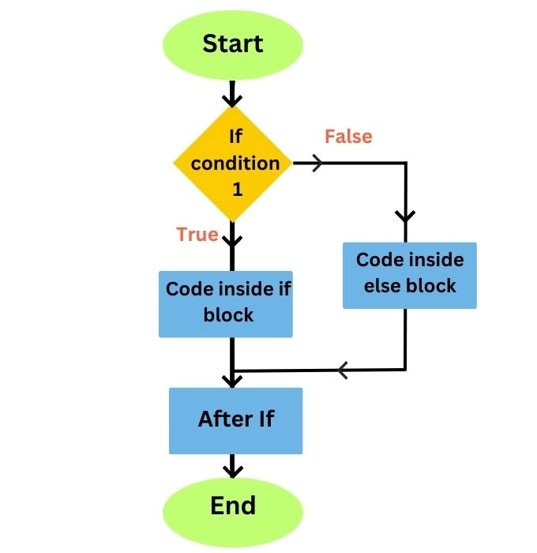
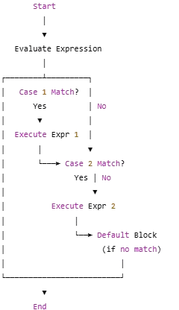
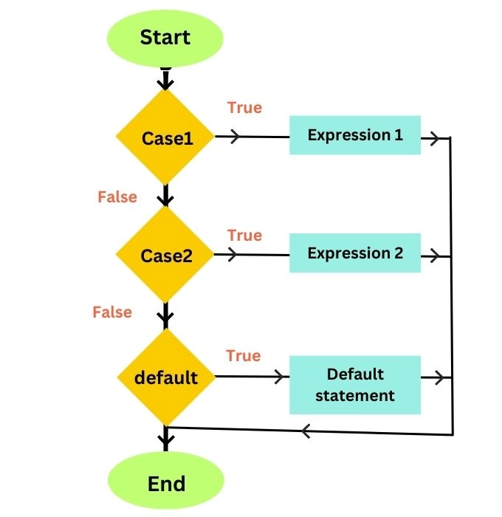
Condition Statement (If & Case)
In PL/SQL, conditions are fundamental to controlling the flow of execution. They allow you to execute specific blocks of code based on whether a particular condition is true or false. The two primary types of conditional statements in PL/SQL are IF statements and CASE statements. Here's a detailed overview of each, along with examples.
If-Else Diagram:
The program checks Condition 1.
If true, it runs the if block.
If false, it runs the else block.
After either block runs, the program continues and ends.
OR
Switch-Case Diagram:
The program checks multiple cases.
If Case 1 matches, it runs Expression 1.
If Case 2 matches, it runs Expression 2.
If no case matches, it runs the default block.
2. The program ends after a match is found or the default runs
Notes:
Explanation
Start: The program begins execution.
Evaluate Expression: The given value is checked against predefined cases.
Check for Case 1:
If Case 1 matches, execute Expression 1, then end the program.
If Case 1 doesn’t match, move to the next case.
Check for Case 2:
If Case 2 matches, execute Expression 2, then end the program.
If Case 2 doesn’t match, move to the next case.
Default Block: If no case matches, execute the default block.
End: The program terminates.
Best practices for conditional statements:
Use indentation and alignment for readability.
Clarify complex conditions with parentheses.
Prefer CASE over nested IF statements for multiple alternatives.
Handle null values using NULLIF and COALESCE functions.
Summary of Conditions
IF Statements: Good for evaluating a single condition or multiple conditions using ELSIF. They are versatile and can be nested.
CASE Statements: More concise when you have multiple conditions based on the same expression. They improve readability when checking the same variable against different values.
Best Practices:
Use IF statements for complex conditions and scenarios where multiple conditions need to be checked.
Use CASE statements when you have multiple values to compare against a single expression for better readability

Slide 26
IF Statements - Syntax
Syntax
DECLARE
score NUMBER := 75; -- Student's score
grade CHAR(1); -- Variable to hold the grade
BEGIN
-- Check if score is within valid range
IF score < 0 OR score > 100 THEN
RAISE_APPLICATION_ERROR(-20001, 'Error: Score must be between 0 and 100.');
END IF;
-- Assign grade based on score
IF score >= 90 THEN
grade := 'A';
ELSIF score >= 80 THEN
grade := 'B';
ELSIF score >= 70 THEN
grade := 'C';
ELSIF score >= 60 THEN
grade := 'D';
ELSE
grade := 'F';
END IF;
-- Output the grade
DBMS_OUTPUT.PUT_LINE('Grade: ' || grade);
EXCEPTION
WHEN VALUE_ERROR THEN
DBMS_OUTPUT.PUT_LINE('Error: Invalid value encountered.');
WHEN OTHERS THEN
DBMS_OUTPUT.PUT_LINE('Unexpected Error: ' || SQLERRM);
END;
/
1. IF-THEN:
IF condition THEN
-- statements to execute if condition is true
END IF;
2. IF-THEN-ELSE:
IF condition THEN
-- statements to execute if condition is true
ELSE
-- statements to execute if condition is false
END IF;
3. IF-THEN-ELSIF:
IF condition1 THEN
-- statements for condition1
ELSIF condition2 THEN
-- statements for condition2
ELSE
-- statements if none of the conditions are true
END IF;
Example Using IF Statement
Notes:
What’s New?
✔ Added input validation: Ensures score is between 0 and 100. ✔ RAISE_APPLICATION_ERROR: Custom error message for invalid input. ✔ Exception Handling:
VALUE_ERROR: Catches invalid number conversions (e.g., if score were assigned an incompatible value).
OTHERS: Catches all unexpected errors and prints a message.
Would you like logging to a table instead of just printing errors? 🚀

Slide 27

📌 Problem Statement: Employee Bonus Update with Error Handling
Scenario:
The HR department wants to update the bonus for employees in the company. However, the system should handle cases where:
The employee ID does not exist in the database.
The bonus amount is negative or invalid.
Any unexpected errors occur.
Write a PL/SQL procedure named update_employee_bonus, which:
Takes p_emp_id (Employee ID) and p_bonus (Bonus amount) as inputs.
Checks if the employee exists before updating.
Updates the bonus field for the given employee.
Uses explicit error handling for possible exceptions.
Rolls back changes in case of failure.
Displays an appropriate success or error message using DBMS_OUTPUT.PUT_LINE.
📝 Sample Inputs & Expected Outputs
Input (p_emp_id, p_bonus) | Expected Output
(101, 5000) | Bonus updated successfully for Employee ID: 101
(999, 3000) | Error: Employee ID 999 does not exist. (ROLLBACK)
(102, -2000) | Error: Invalid bonus value. Must be a positive number. (ROLLBACK)
(103, 'ABC') | Error: Invalid bonus value. Please enter a valid number. (ROLLBACK)
🔹 Additional Question for Students
Why is it important to ROLLBACK changes when an error occurs?
What happens if we remove the ROLLBACK from the procedure?
How can we modify the procedure to log errors into a separate database table instead of just displaying messages?
Notes:
What’s New?
✔ Added input validation: Ensures score is between 0 and 100. ✔ RAISE_APPLICATION_ERROR: Custom error message for invalid input. ✔ Exception Handling:
VALUE_ERROR: Catches invalid number conversions (e.g., if score were assigned an incompatible value).
OTHERS: Catches all unexpected errors and prints a message.
Would you like logging to a table instead of just printing errors? 🚀

Slide 28
Code Implementation
CREATE OR REPLACE PROCEDURE update_employee_bonus (
p_emp_id IN NUMBER,
p_bonus IN NUMBER
)
AS
v_count NUMBER;
BEGIN
-- Check if employee exists
SELECT COUNT(*) INTO v_count FROM employees WHERE employee_id = p_emp_id;
IF v_count = 0 THEN
RAISE_APPLICATION_ERROR(-20002, 'Error: Employee ID ' || p_emp_id || ' does not exist.');
END IF;
-- Update the employee's bonus
UPDATE employees
SET bonus = p_bonus
WHERE employee_id = p_emp_id;
-- Commit if successful
COMMIT;
DBMS_OUTPUT.PUT_LINE('Bonus updated successfully for Employee ID: ' || p_emp_id);
EXCEPTION
WHEN NO_DATA_FOUND THEN
-- Employee ID not found
ROLLBACK;
DBMS_OUTPUT.PUT_LINE('Error: Employee ID ' || p_emp_id || ' not found.');
WHEN VALUE_ERROR THEN
-- Handles invalid number format
ROLLBACK;
DBMS_OUTPUT.PUT_LINE('Error: Invalid bonus value. Please enter a valid number.');
WHEN DUP_VAL_ON_INDEX THEN
-- Handles duplicate constraint violations
ROLLBACK;
DBMS_OUTPUT.PUT_LINE('Error: Duplicate value found for a unique column.');
WHEN OTHERS THEN
-- Handles all unexpected errors
ROLLBACK;
DBMS_OUTPUT.PUT_LINE('Unexpected Error: ' || SQLERRM);
END;
/
Example Execution
BEGIN
update_employee_bonus(101, 5000);
END;
/
Notes:
🔹 How It Works
Validates p_emp_id
Checks if the employee exists before updating.
Raises an error if the employee does not exist.
Updates the bonus
If the employee exists, updates their bonus.
Uses COMMIT to save changes.
Exception Handling
NO_DATA_FOUND → Employee ID does not exist.
VALUE_ERROR → Invalid data format for bonus.
DUP_VAL_ON_INDEX → If a unique constraint is violated.
OTHERS → Catches all unexpected errors.
✅ Why This is a Good Approach?
✔ Prevents updating non-existing employees ✔ Uses clear, descriptive error messages ✔ Ensures data consistency with ROLLBACK on failure ✔ Handles multiple error cases explicitly

Slide 29
PL/SQL Stored Procedure in Oracle – Real Example
In Oracle PL/SQL, a stored procedure is a named block that performs a specific task. Below is a real-world example of how you can create, alter, execute, and drop a stored procedure in Oracle.
Scenario: Managing Employee Salary Updates
We will create a stored procedure that updates an employee’s salary in an employees table.
A
B
CREATE OR REPLACE PROCEDURE update_employee_salary (
p_emp_id IN NUMBER,
p_new_salary IN NUMBER
)
AS
BEGIN
-- Attempt to update the salary
UPDATE employees
SET salary = p_new_salary
WHERE emp_id = p_emp_id;
-- Commit changes if no error occurs
COMMIT;
DBMS_OUTPUT.PUT_LINE('Salary updated successfully for Employee ID: ' || p_emp_id);
EXCEPTION
WHEN NO_DATA_FOUND THEN
-- If no matching employee is found, rollback and display an error
ROLLBACK;
DBMS_OUTPUT.PUT_LINE('Error: Employee ID ' || p_emp_id || ' not found.');
WHEN OTHERS THEN
-- Catch any other errors, rollback, and display the error message
ROLLBACK;
DBMS_OUTPUT.PUT_LINE('Error updating salary: ' || SQLERRM);
END;
/
CREATE OR REPLACE PROCEDURE update_employee_salary (
p_emp_id IN NUMBER,
p_new_salary IN NUMBER
)
AS
BEGIN
UPDATE employees
SET salary = p_new_salary
WHERE emp_id = p_emp_id;
COMMIT; -- Save changes if the update is successful
EXCEPTION
WHEN OTHERS THEN
ROLLBACK; -- Revert changes in case of an error
DBMS_OUTPUT.PUT_LINE('Error updating employee salary: ' || SQLERRM);
END;
/
1. Creating the Procedure
This procedure updates the salary of an employee based on their ID.
2. Executing the Procedure
After creating the procedure, we can call it using
BEGIN
update_employee_salary(101, 5000); -- Updates employee with ID 101 to a salary of 5000
END;
/
Notes:
Why Is This Better?
✔ Prevents committing partial updates if errors occur ✔ Improves debugging by providing meaningful error messages ✔ Ensures data consistency with rollback in case of failures
Would you like to include logging into a table instead of just printing errors? 🚀
B
Explanation:
Normal Execution: The UPDATE statement modifies the salary for the specified employee. If everything runs smoothly, the transaction is committed with COMMIT;.
Exception Handling: If an error occurs during the update, the EXCEPTION block catches it.
The ROLLBACK; ensures that any changes made during this transaction are undone.
DBMS_OUTPUT.PUT_LINE prints a descriptive error message that includes the SQL error message (SQLERRM).
This structure ensures that your database remains consistent and any issues are logged appropriately.

Slide 30
📌 Problem Statement: Employee Bonus Update with Error Handling
Notes:
What’s New?
✔ Added input validation: Ensures score is between 0 and 100. ✔ RAISE_APPLICATION_ERROR: Custom error message for invalid input. ✔ Exception Handling:
VALUE_ERROR: Catches invalid number conversions (e.g., if score were assigned an incompatible value).
OTHERS: Catches all unexpected errors and prints a message.
Would you like logging to a table instead of just printing errors? 🚀

Slide 31
PL/SQL Stored Procedure in Oracle – Real Example
CREATE OR REPLACE PROCEDURE update_employee_salary (
p_emp_id IN NUMBER,
p_new_salary IN NUMBER
)
AS
v_min_salary NUMBER := 3000; -- Define a minimum salary
BEGIN
IF p_new_salary < v_min_salary THEN
RAISE_APPLICATION_ERROR(-20001, 'Salary cannot be less than 3000');
ELSE
UPDATE employees
SET salary = p_new_salary
WHERE emp_id = p_emp_id;
COMMIT;
END IF;
END;
/
3. Altering the Procedure
If we want to modify the procedure, for example, to add a condition that prevents setting a salary below a minimum threshold, we use CREATE OR REPLACE:
4. Dropping the Procedure
To remove the procedure from the database:
DROP PROCEDURE update_employee_salary;
Notes:
"alter" a procedure means to modify an existing stored procedure in a database, while "drop" a procedure means to completely delete it from the database;

Slide 32
PL/SQL Stored Procedure in Oracle – Real Example
GRANT EXECUTE ON update_employee_salary TO hr_user;
5. Granting Permission to Execute the Procedure
If another user needs to execute the procedure, you can grant access:
6. Checking Existing Procedures in the Database
To list all procedures in the system:
SELECT OBJECT_NAME FROM USER_PROCEDURES;
Action | SQL Command
Create a procedure | CREATE OR REPLACE PROCEDURE procedure_name AS BEGIN ... END;
Execute a procedure | BEGIN procedure_name(parameters); END; /
Alter a procedure | CREATE OR REPLACE PROCEDURE procedure_name AS BEGIN ... END;
Drop a procedure | DROP PROCEDURE procedure_name;
Grant execution rights | GRANT EXECUTE ON procedure_name TO user;
Check stored procedures | SELECT * FROM USER_PROCEDURES;
Summary
Notes:
"alter" a procedure means to modify an existing stored procedure in a database, while "drop" a procedure means to completely delete it from the database;

Slide 33
CASE Statements
The CASE statement is useful when you have multiple conditions based on the same expression. It evaluates an expression and executes the corresponding block of code for the first matching value.
2. SEARCH CASE:
CASE
WHEN condition1 THEN
-- statements
WHEN condition2 THEN
-- statements
ELSE
-- statements if no conditions match
END CASE;
SIMPLE CASE:
CASE expression
WHEN value1 THEN
-- statements
WHEN value2 THEN
-- statements
ELSE
-- statements if no values match
END CASE;
Notes:
💡 Explanation of Changes:
Handling Invalid Grades:
If the grade does not match 'A', 'B', 'C', 'D', or 'F', the program raises an application error (-20001).
Exception Handling (EXCEPTION Block):
If any unexpected errors occur, they are caught using WHEN OTHERS THEN.
The error message is displayed using SQLERRM, which provides details about the error.
📝 Sample Inputs & Expected Outputs
gradeExpected Output'A'Message: Excellent work!'B'Message: Good job!'F'Message: Failed. Please try again.'X'Error occurred: ORA-20001: Invalid grade entered.🔹
Questions for Further Learning
Why is RAISE_APPLICATION_ERROR useful instead of just assigning a message?
How can you modify this procedure to log errors into an error-tracking table instead of just printing them?
How would you modify this if grade were stored in a database column instead of a variable?
Let me know if you need any modifications! 🚀

Slide 34
Example: CASE Statements
The CASE statement is useful when you have multiple conditions based on the same expression. It evaluates an expression and executes the corresponding block of code for the first matching value.
Example Using CASE Statement:
📝 Sample Inputs & Expected Outputs
DECLARE
grade CHAR(1) := 'B'; -- Example grade
message VARCHAR2(100); -- Variable to hold the message
BEGIN
CASE grade
WHEN 'A' THEN
message := 'Excellent work!';
WHEN 'B' THEN
message := 'Good job!';
WHEN 'C' THEN
message := 'Fair performance.';
WHEN 'D' THEN
message := 'Needs improvement.';
WHEN 'F' THEN
message := 'Failed. Please try again.';
ELSE
RAISE_APPLICATION_ERROR(-20001, 'Invalid grade entered.');
END CASE;
DBMS_OUTPUT.PUT_LINE('Message: ' || message);
EXCEPTION
WHEN OTHERS THEN
DBMS_OUTPUT.PUT_LINE('Error occurred: ' || SQLERRM);
END;
/
grade | Expected Output
'A' | Message: Excellent work!
'B' | Message: Good job!
'F' | Message: Failed. Please try again.
'X' | Error occurred: ORA-20001: Invalid grade entered.
🔹 Questions for Further Learning
Why is RAISE_APPLICATION_ERROR useful instead of just assigning a message?
How can you modify this procedure to log errors into an error-tracking table instead of just printing them?
How would you modify this if grade were stored in a database column instead of a variable?
Notes:
💡 Explanation of Changes:
Handling Invalid Grades:
If the grade does not match 'A', 'B', 'C', 'D', or 'F', the program raises an application error (-20001).
Exception Handling (EXCEPTION Block):
If any unexpected errors occur, they are caught using WHEN OTHERS THEN.
The error message is displayed using SQLERRM, which provides details about the error.
📝 Sample Inputs & Expected Outputs
gradeExpected Output'A'Message: Excellent work!'B'Message: Good job!'F'Message: Failed. Please try again.'X'Error occurred: ORA-20001: Invalid grade entered.🔹
Questions for Further Learning
Why is RAISE_APPLICATION_ERROR useful instead of just assigning a message?
How can you modify this procedure to log errors into an error-tracking table instead of just printing them?
How would you modify this if grade were stored in a database column instead of a variable?
Let me know if you need any modifications! 🚀

Slide 35
PL/SQL Using GOTO Statement
The GOTO statement in PL/SQL allows you to transfer control unconditionally to a labeled section of the code. It can be used in some cases, but it's generally discouraged due to readability and maintainability issues.
Basic Example of GOTO
DECLARE
salary NUMBER := 5000;
BEGIN
IF salary < 10000 THEN
GOTO low_salary;
END IF;
DBMS_OUTPUT.PUT_LINE('Salary is sufficient.');
GOTO end_program;
<<low_salary>>
DBMS_OUTPUT.PUT_LINE('Salary is too low, consider a raise.');
<<end_program>>
NULL;
END;
/
Explanation
If salary < 10000, it jumps to <<low_salary>> and prints "Salary is too low".
After printing, it does not return back but continues execution.
GOTO end_program ensures no unintended execution happens after the first message.
Notes:
In PL/SQL, the NULLIF and COALESCE functions are useful when dealing with NULL values in a query or logic block.

Slide 36
GOTO with Loops and Conditions
The GOTO statement in PL/SQL allows you to transfer control unconditionally to a labeled section of the code. It can be used in some cases, but it's generally discouraged due to readability and maintainability issues.
Basic Example of GOTO
DECLARE
counter NUMBER := 1;
BEGIN
<<start_loop>>
DBMS_OUTPUT.PUT_LINE('Iteration: ' || counter);
counter := counter + 1;
IF counter <= 5 THEN
GOTO start_loop; -- Jumps back to start_loop
END IF;
DBMS_OUTPUT.PUT_LINE('Loop completed.');
END;
/
Explanation
It simulates a loop using GOTO.
Prints "Iteration: X" for X = 1 to 5, then exits.

Slide 37
GOTO with Exception Handling
DECLARE
num NUMBER := 10;
BEGIN
IF num < 0 THEN
GOTO error_label;
END IF;
DBMS_OUTPUT.PUT_LINE('Number is positive.');
GOTO end_program;
<<error_label>>
DBMS_OUTPUT.PUT_LINE('Error: Negative number detected.');
<<end_program>>
NULL;
END;
/
Explanation
If num < 0, the control jumps to error_label and prints an error message.
Ensures program does not execute unnecessary code after an error.

Slide 38

🚀 Why GOTO?
🚀 Why GOTO is Rarely Used?
Makes code harder to read and debug.
Can lead to "spaghetti code" (too many jumps).
Loops (FOR, WHILE) and CASE statements usually replace it.
📝 Key Questions
When is GOTO justified in PL/SQL?
How can you replace GOTO with structured control flow?
What happens if a GOTO jumps over an EXCEPTION block?

Slide 40
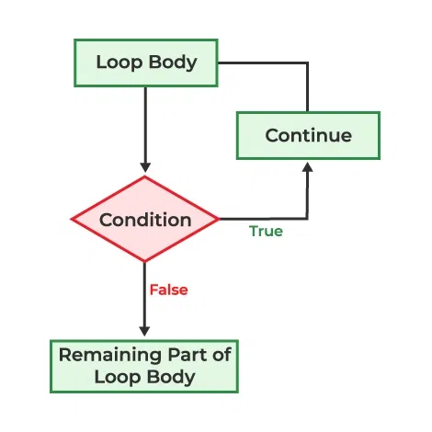
Loops in PL/SQL
Why Use Loops in PL/SQL?
Loops are essential in PL/SQL programming because they allow you to repeat a set of statements multiple times without rewriting code. They help in:
Automating Repetitive Tasks
Instead of writing duplicate SQL statements, loops repeat them dynamically. Example: Updating salaries for all employees in a department.
PL/SQL supports several looping constructs:
Basic Loop (infinite until EXIT)
WHILE Loop (repeats while a condition is TRUE)
FOR Loop (repeats for a fixed number of times)
Source Image: https://www.geeksforgeeks.org/plsql-loops/

